Slide 1
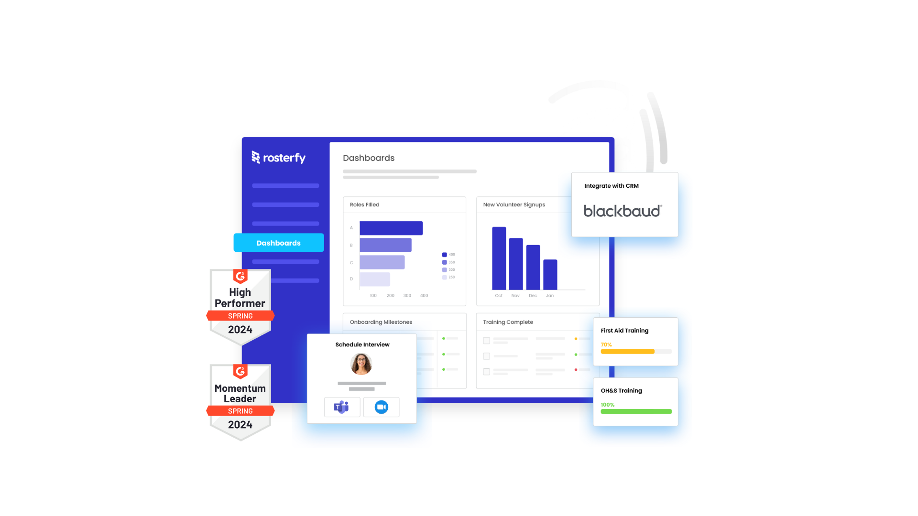
Bring Volunteer Management to Life with Rosterfy
Blackbaud and Rosterfy integration for non profit organisations

Slide 2

“Connecting Communities to events and causes they are passionate about”
The mission…
Bennett Merriman, CEO
Rosterfy

Slide 3

Rosterfy is Global
Charities and nonprofits, cities, governments, universities and sporting federations all choose the most scalable volunteer and workforce platform on the market…. Rosterfy.
Over 100 million hours of volunteering have been managed through Rosterfy across the globe.
Rosterfy brings volunteer management to life!

Slide 4
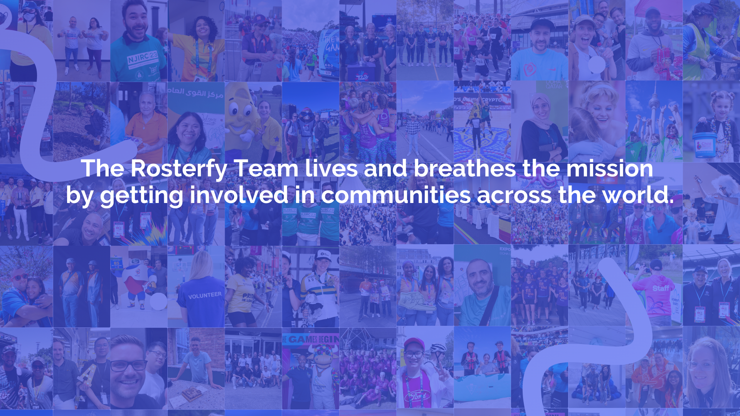

Slide 5



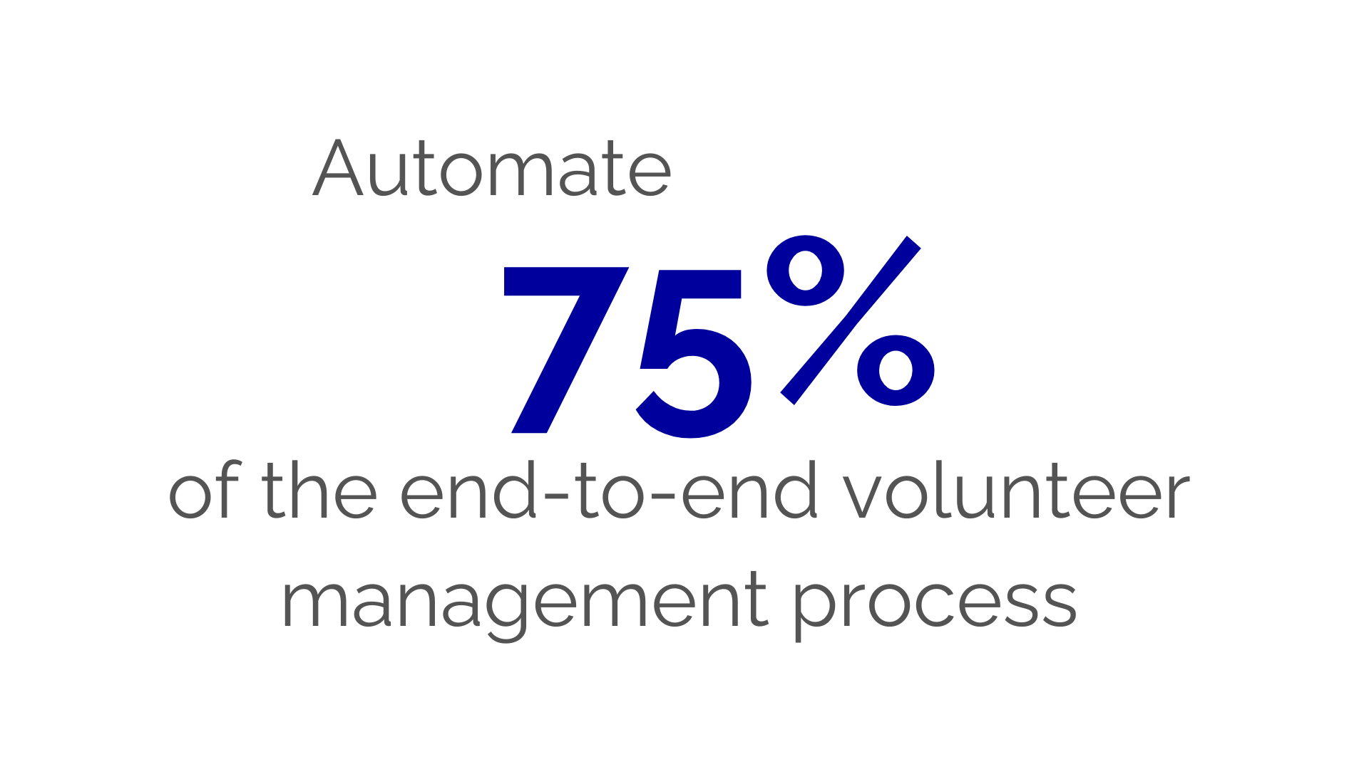
Best in class Volunteer Management Software

Slide 6




















Trusted to deliver a great experience

Slide 7
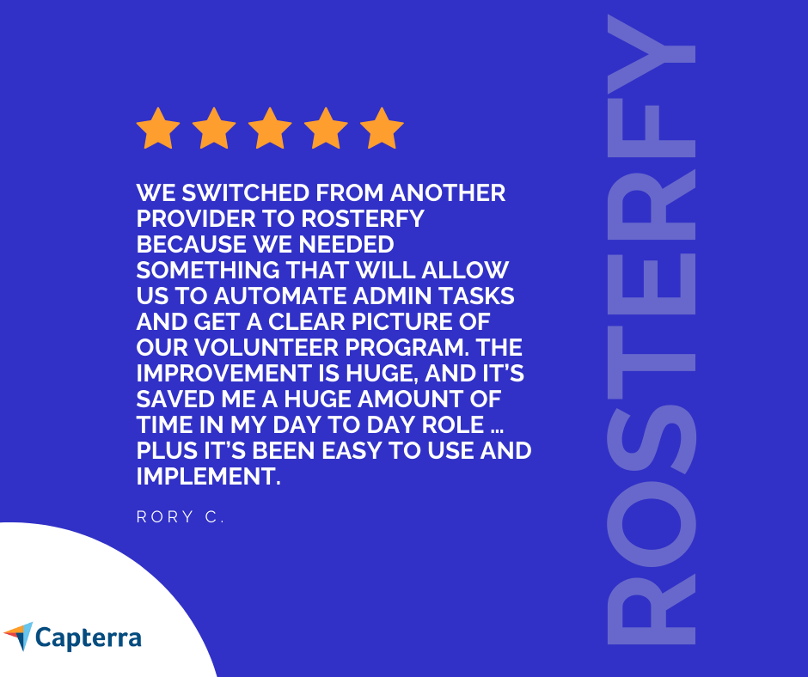
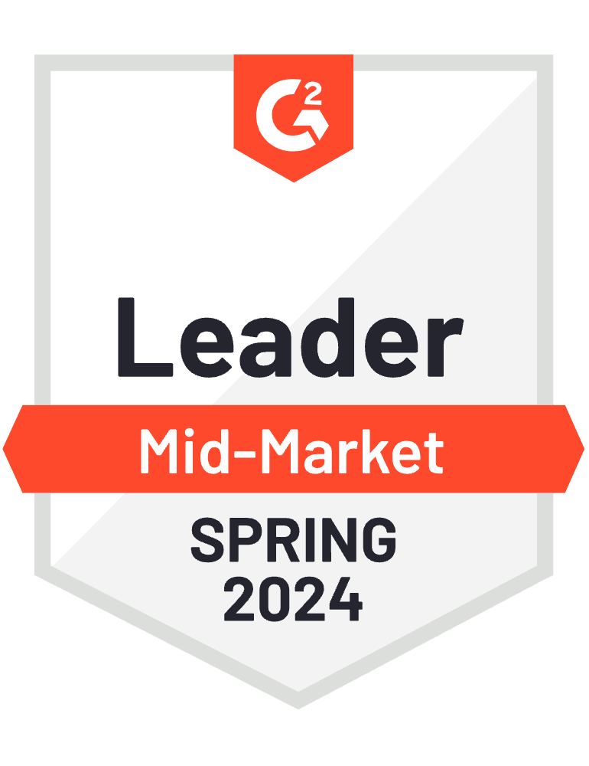
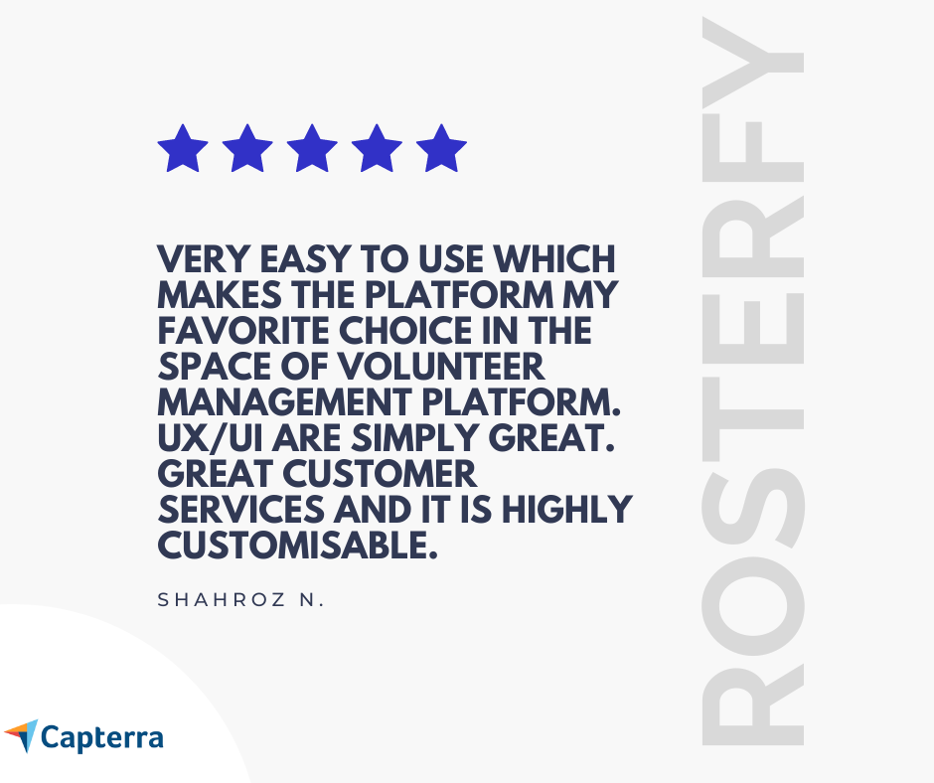
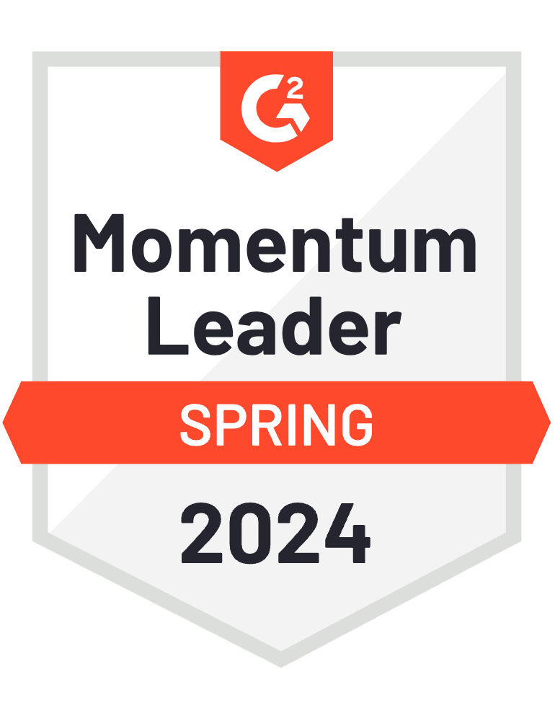
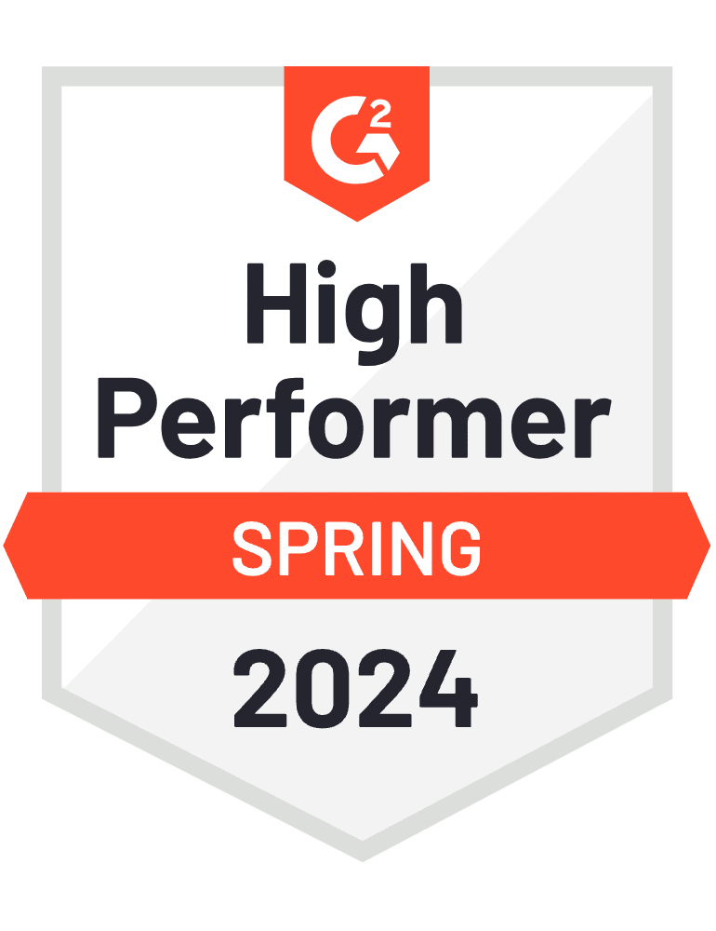

Slide 8
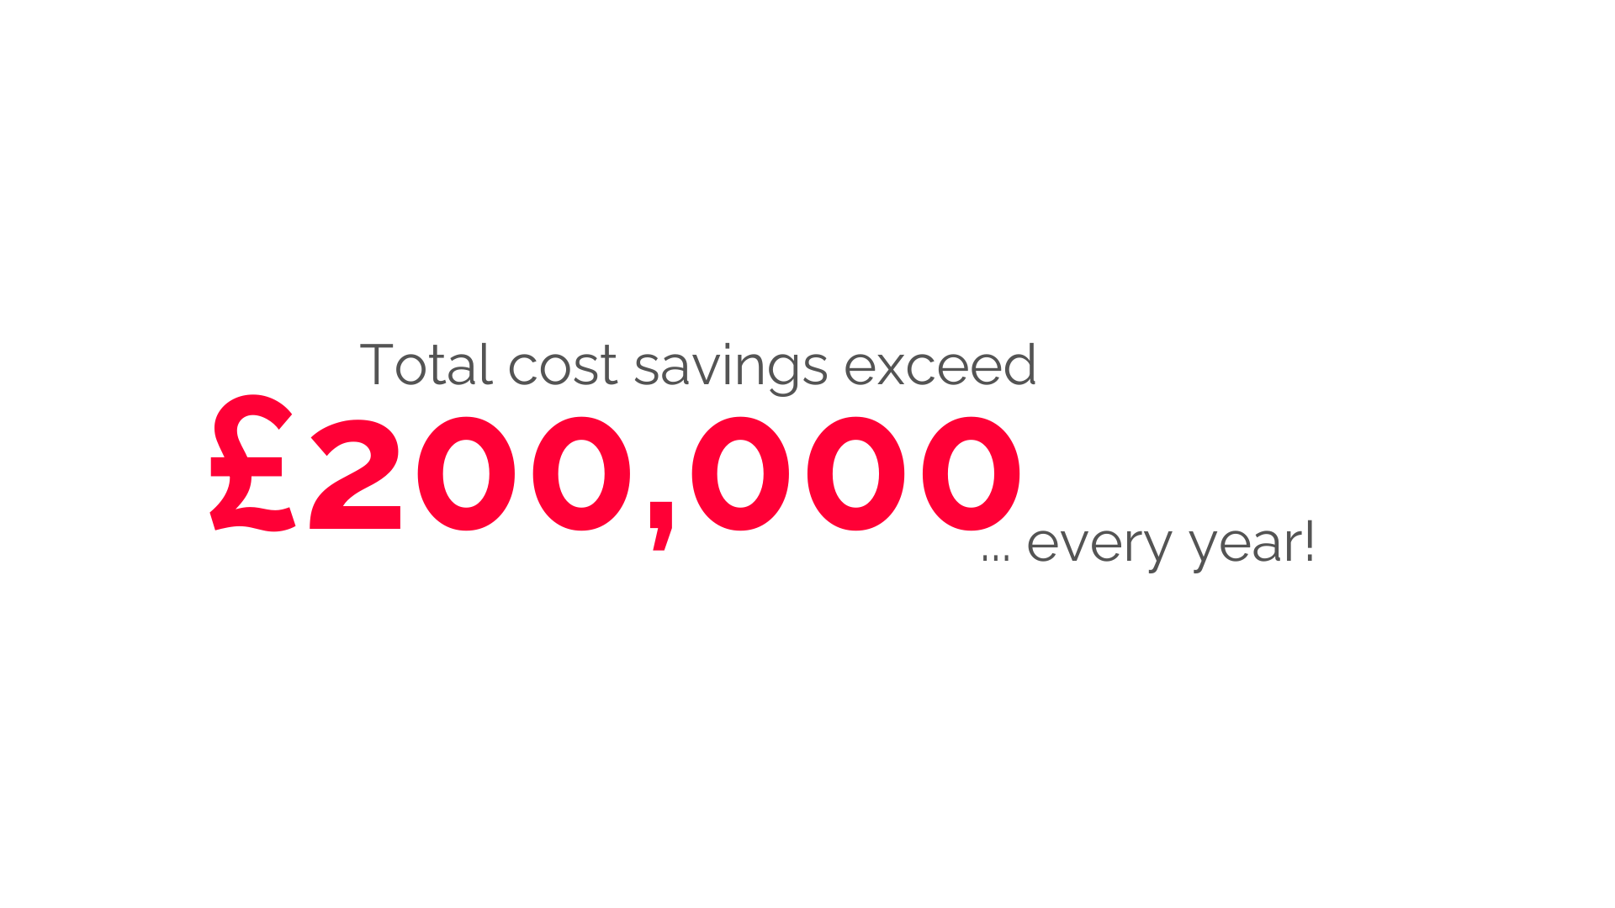

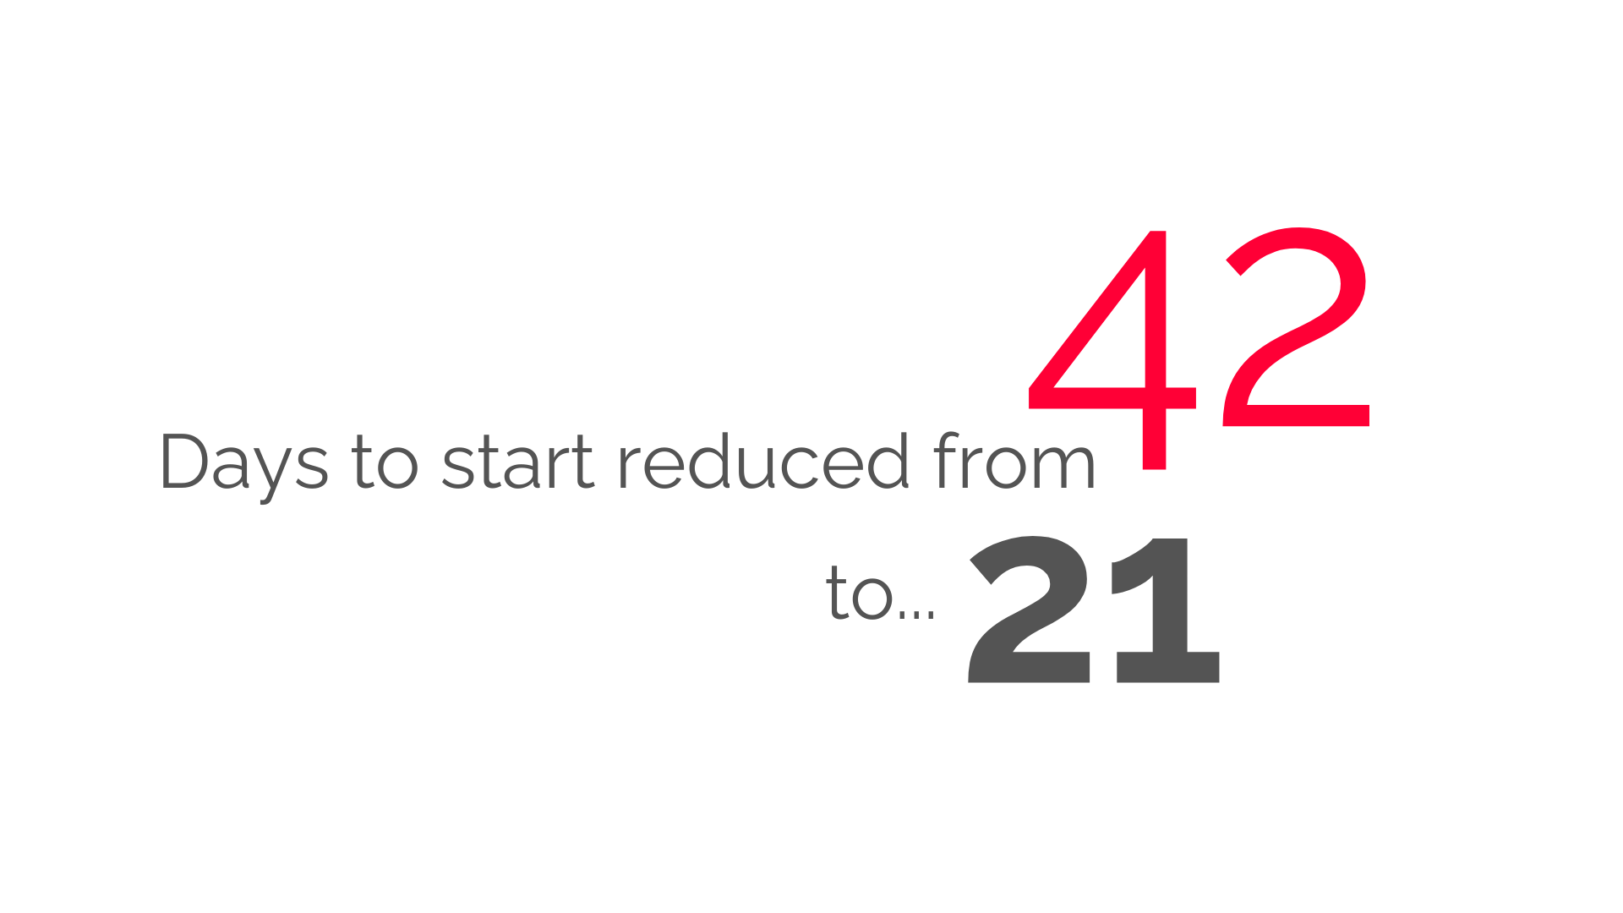
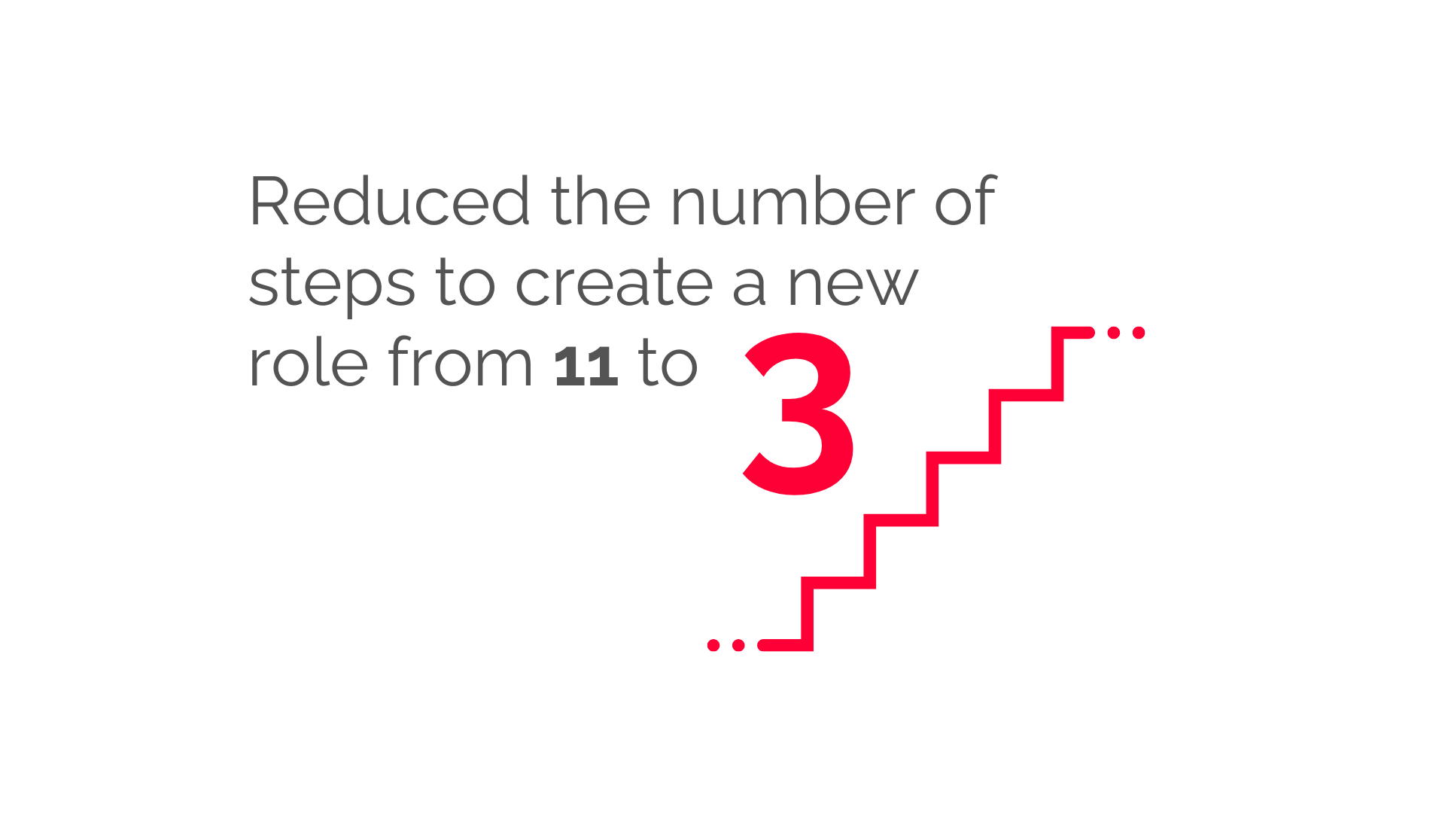
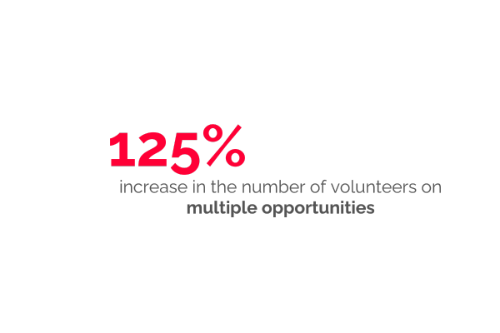
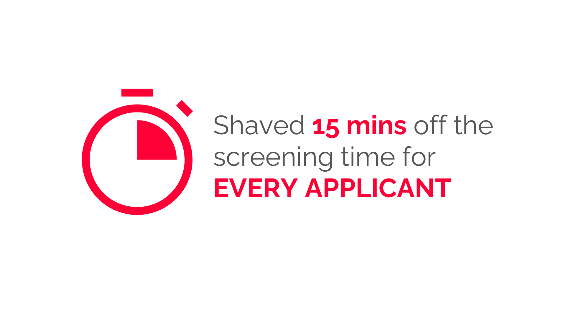
Imagine what you could achieve?
Find out more

Slide 9
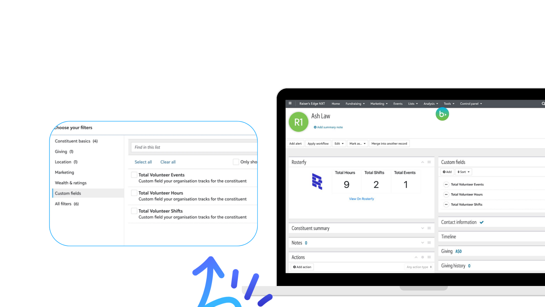
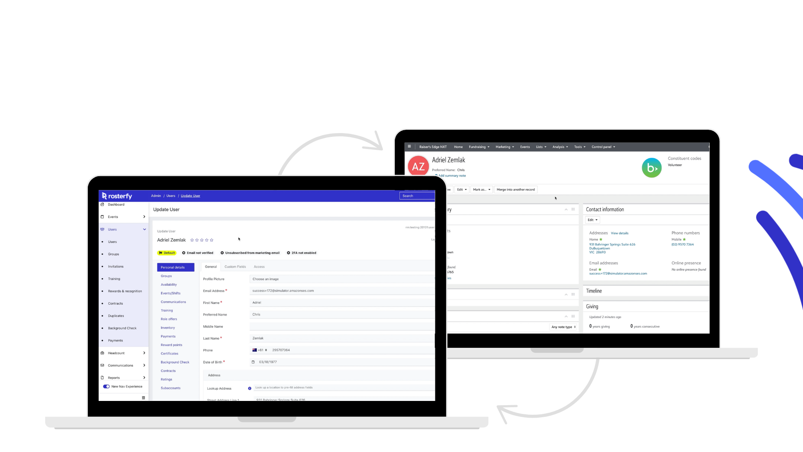
Better Together: Rosterfy + Raiser’s Edge
Get a single view of your constituent’s donation and volunteer history - reduce admin duplication and data entry errors.
Information passed between the two platforms
Personal Information
Constituent Notes
Constituent Actions - NXT Completed actions (signed waiver)
Constituent Consent Code
Communication Permissions
Embedded Volunteer Tile
Related Constituent
Download Reports on all information via Raiser’s Edge Modules
Near Real-Time data sync between Rosterfy + Raiser’s Edge
Blackbaud CRM Integration… Coming Soon.

Slide 10

Benefits of integrating Rosterfy with Blackbaud
Ensure that your
data is up to date across both
Blackbaud and Rosterfy
without the need for
manual editing or
multiple accounts.
Offer a unique
experience for your
Volunteers empowering them to take control of
their volunteer and
fundraising efforts.
Keep your data secure,
safe and protected to
ensure that you remain
compliant.
Track volunteer
engagement,
attendance and
fundraising via live
dashboards within
your account.
Find out more

Slide 11
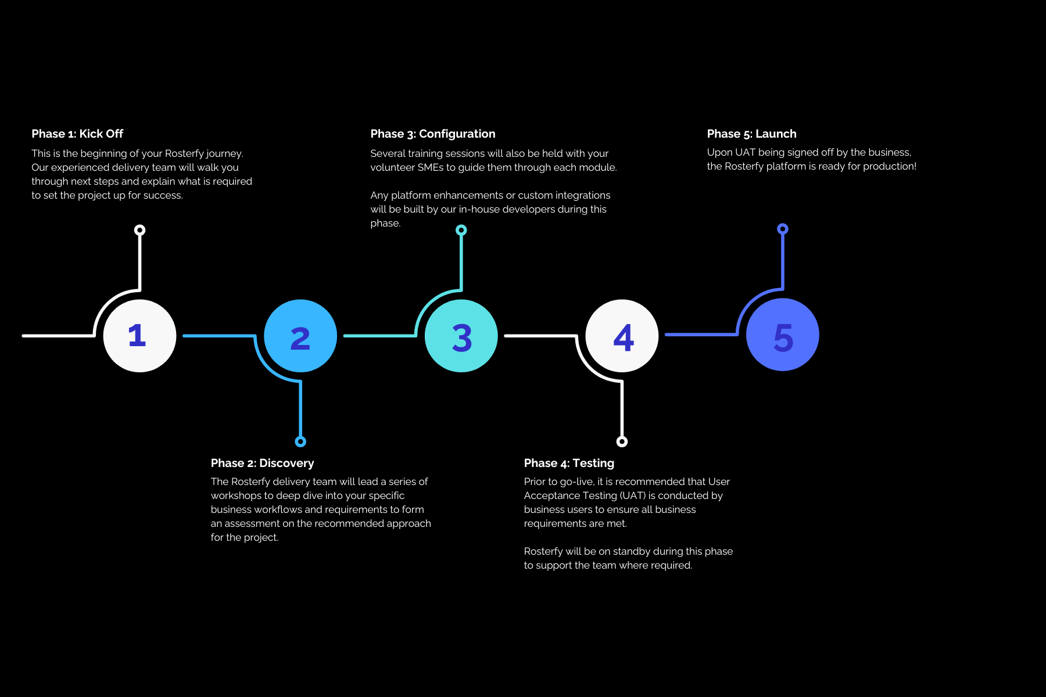
An experienced team taking you step-by-step
5
Find out more

Slide 12
www.rosterfy.com

